Slide 1
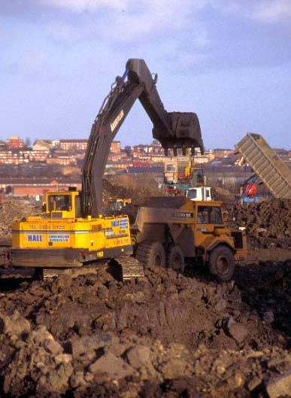
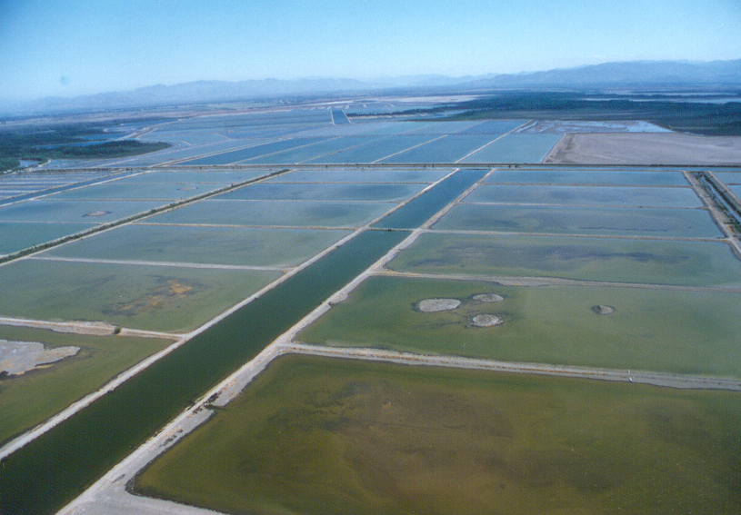
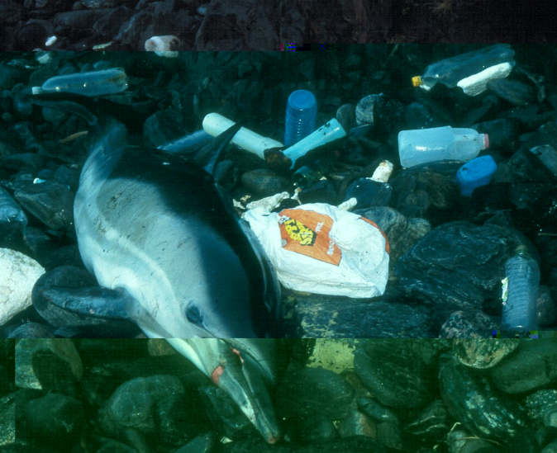
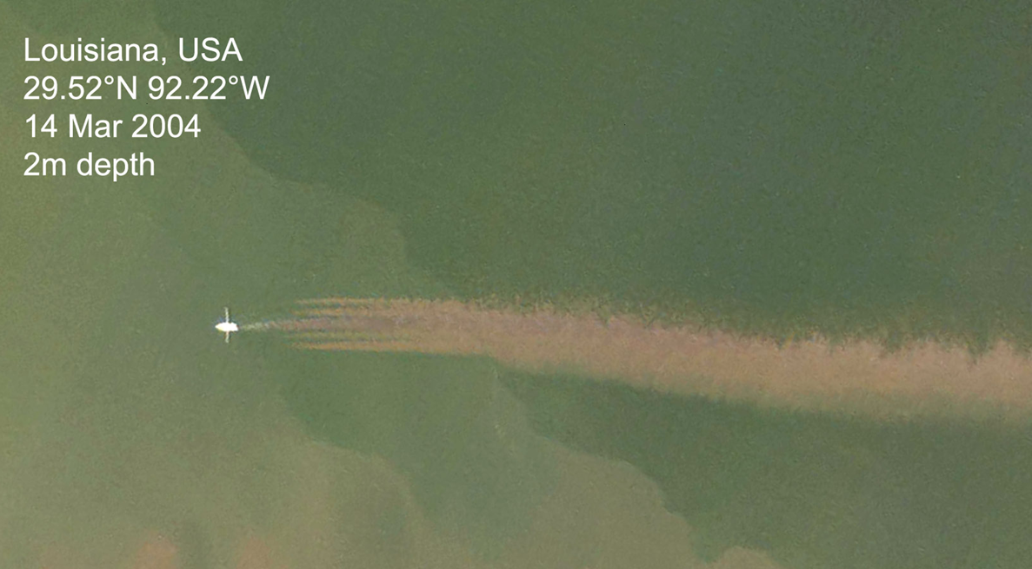
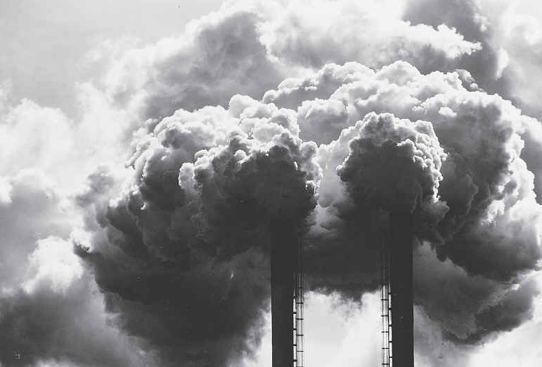
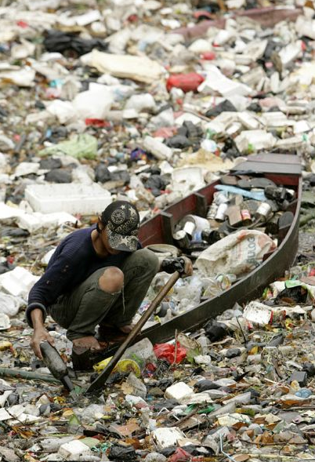
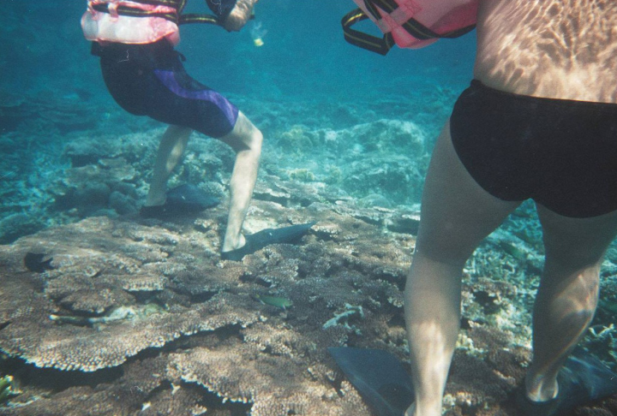
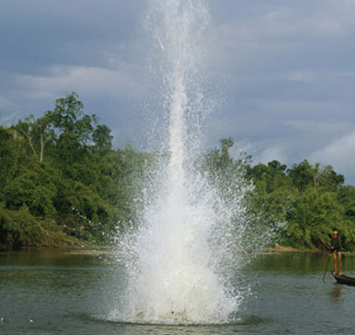
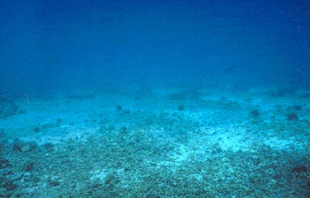
Causes of biodiversity loss: Habitat loss
Reduction of hospitable locations for individuals of a species

Slide 2
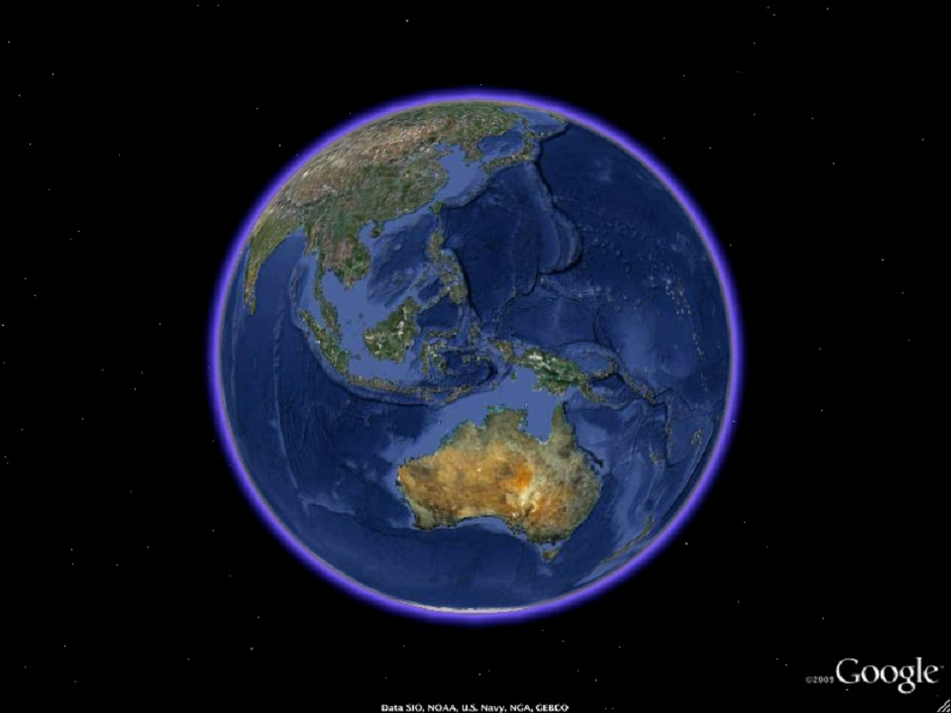
Magnitude of habitat destruction

Slide 3
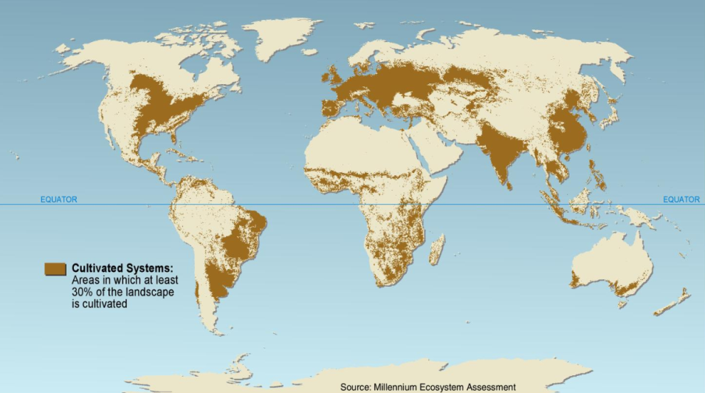
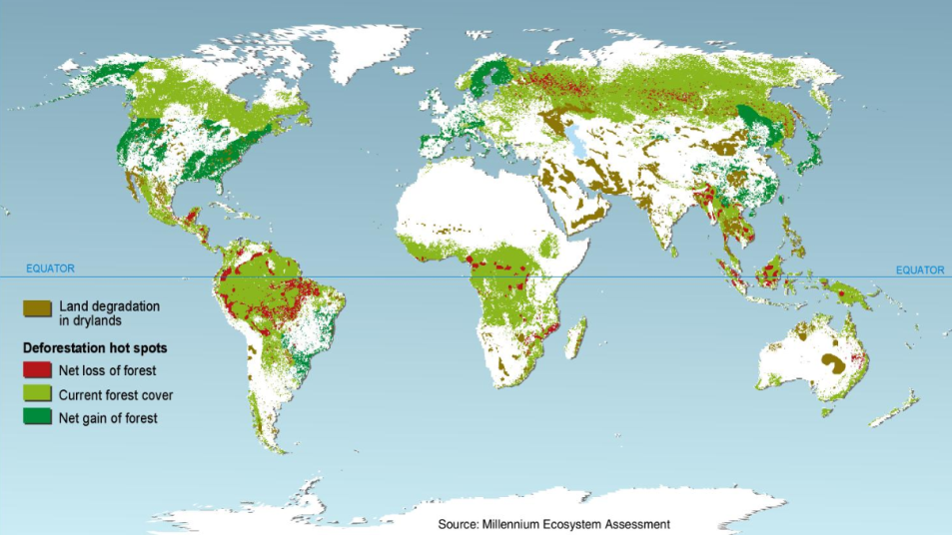
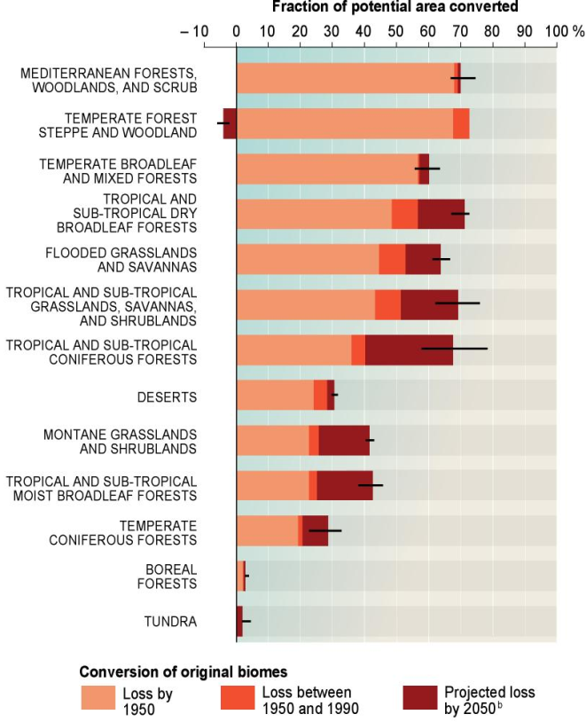
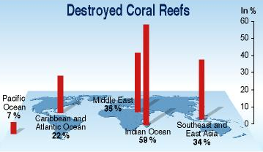
And the extent of these losses are huge and global
Land already used for agriculture
Deforestation pattern
38% of the world’s terrestrial surface (Foley et al. Nature 2011)
7 to 10 million hectares deforested every year (FAO 2011)
25% of the world’s reefs destroyed (Reef at Risk 2004)
Millennium Ecosystem Assessment

Slide 4
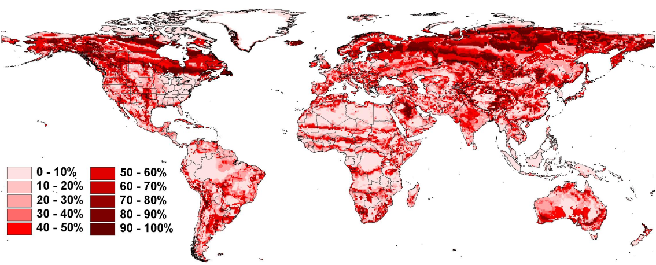
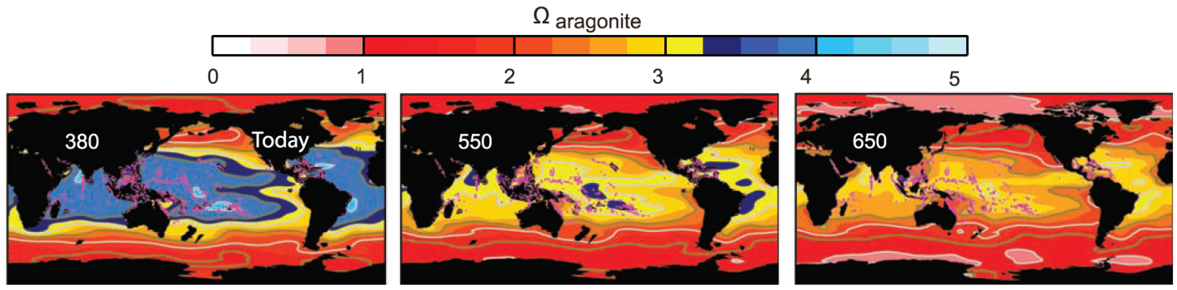
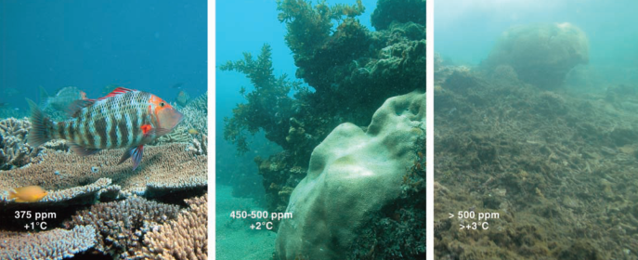
And things are expected to get worse
On land
Global loss of suitable habitats due to a doubling CO2 to 2050
Malcolm & Markham (Global Warming and terrestrial Biodiversity Decline, WWF 2000)
… and Ocean
Hoegh-Guldberg et al (Science 2006)

Slide 5
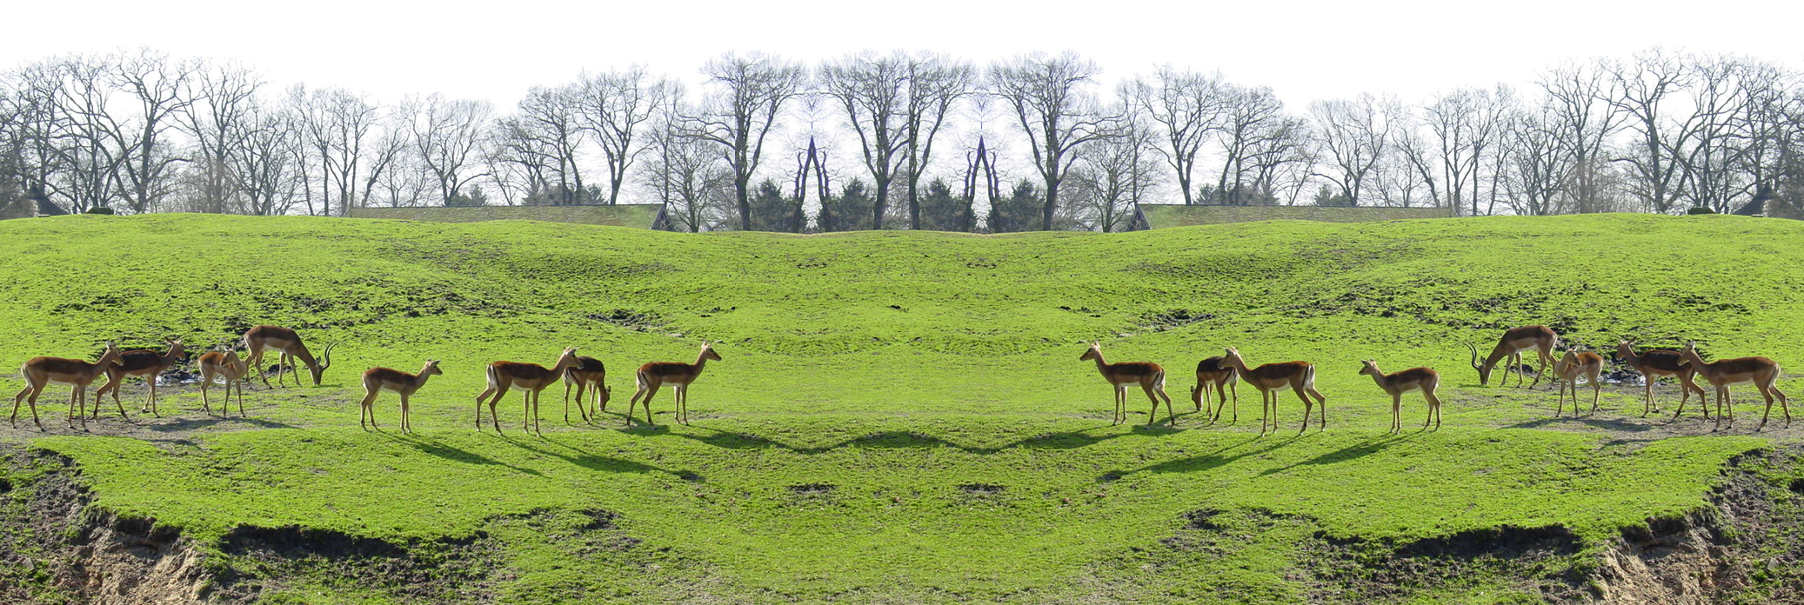
How does habitat loss affect biodiversity?
In some cases, where species are sedentary, the effect is direct, however, for most species the effect is indirect.
Metapopulation dynamics: ensemble of inhabited patches interconnected by dispersing propagules
Input of individuals
Immigration
Natality
Output of individuals
Migration
Mortality

Slide 6
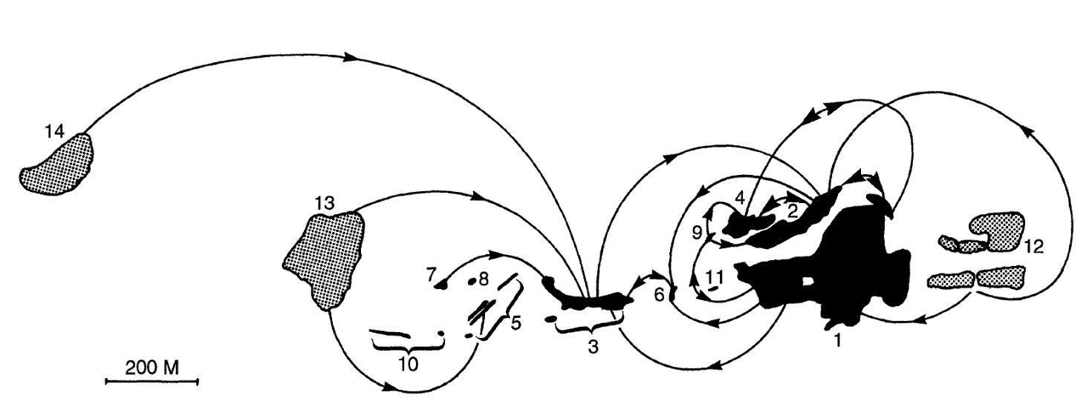
Important attributes for the maintenance of a metapopulation:
Colonized patches of a butterfly species (Hill et al, J. Anim. Ecol. 1996)
Patch isolation
Patch quality
Patch size

Slide 7
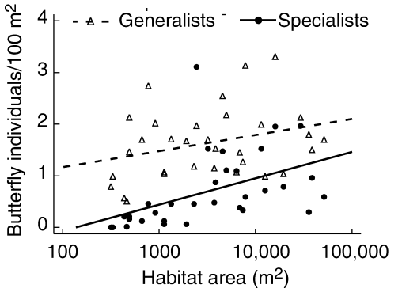
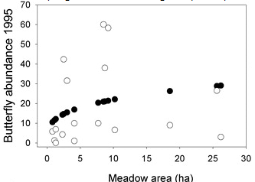
Patch size
The larger a patch the larger the populations
Krauss et al (J Biogeogr. 2003)
Matter et al (Amer. Nat. 2003)

Slide 8
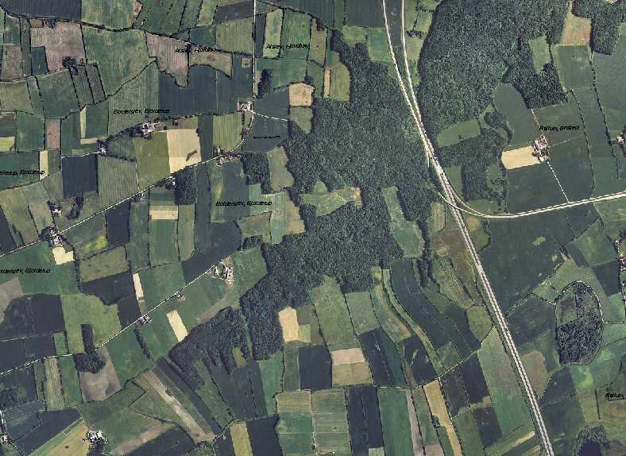
Patch size
Edge effects
increased risk of parasitism or disease
increased risk of predation
adverse microclimate conditions
The larger patch the smaller the edge effects

Slide 9
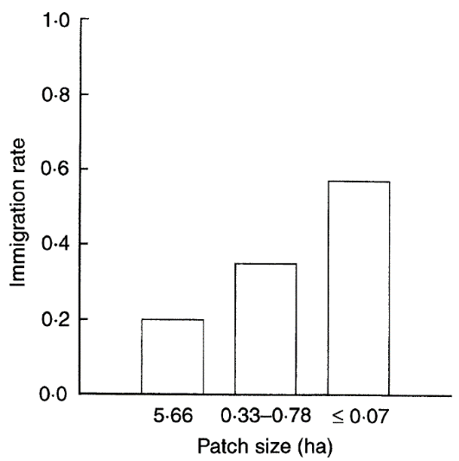
Patch size
The larger a patch the larger the rate of immigration
Immigration in a butterfly species
Hill et al (J. Anim. Ecol. 1996)

Slide 10
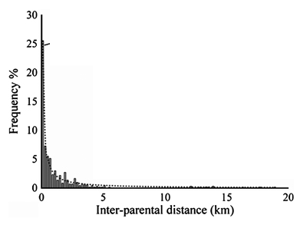
Patch isolation
Most commonly most individuals of a species disperse short distances
Dispersal distances of seeds of forest tree (Sorbus domestica)
Kamm et al (Heredety 2009)
The larger the connectivity the larger the input of new individuals

Slide 11
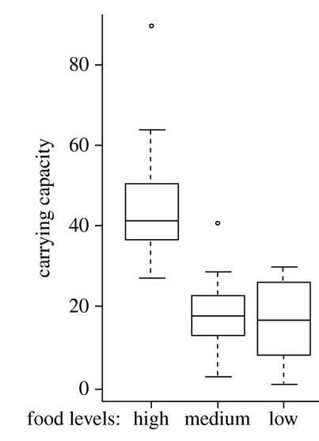
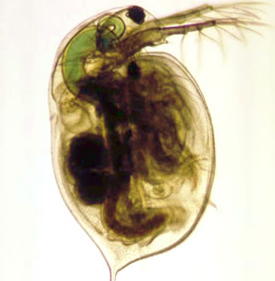
Patch quality
Experimental populations of Daphnia magna
Griffen & Drake (Proc. Biol. Sci. 2008)
The better the quality of habitat the larger the populations and resilience of their individuals

Slide 12
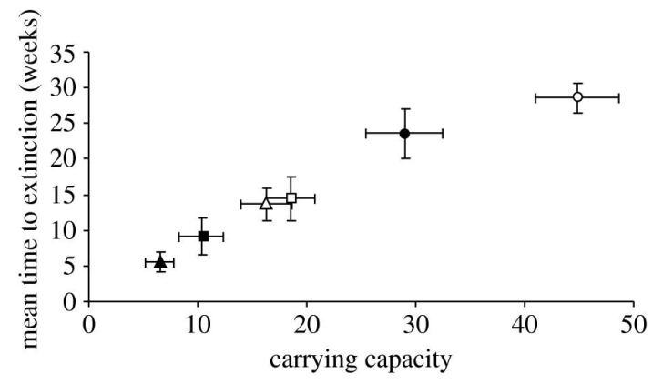
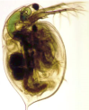
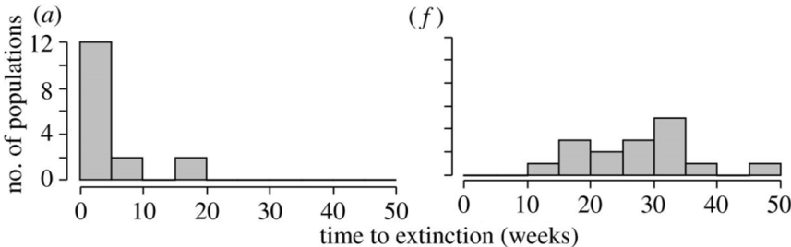
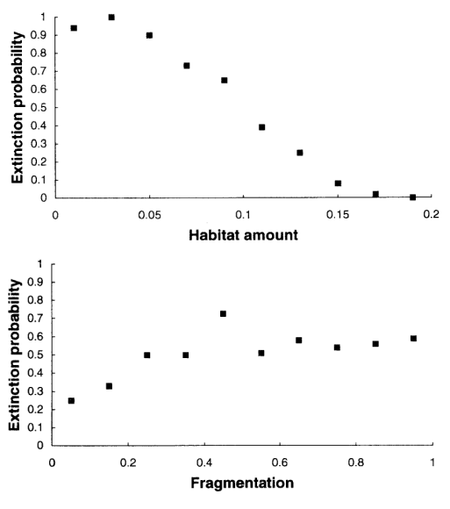
Rules of thumb about habitat in metapopulations
The larger a patch the larger the populations
Effect of patch size
Griffen & Drake (Proc. Biol. Sci. 2008)
The larger patch the smaller the edge effects
The larger a patch the larger the rate of immigration
Low food/small patch
high food/large patch
Effect of patch size and quality
The larger the connectivity the larger the input of new individuals
Griffen & Drake (Proc. Biol. Sci. 2008)
The better the quality of habitat the larger the populations and resilience of their individuals
Simulation model
Effect of patch isolation
Fahrig (J. Wild. Mang. 1997)
Habitat loss can reduce populations and cause extinctions through multiple mechanisms mediated by the amount, patchiness and quality of habitats

Slide 13
The effect may not be apparent soon: habitat destruction and extinction debt
Population A
Population A1
Population A2
Population size
Population Extinct
Time
Time lag or extinction debt
Habitat loss impact
Habitat loss response
Habitat loss may disrupt ecological processes that may over time lead to species extinction
Tilman et al (Nature 2002)

Slide 14
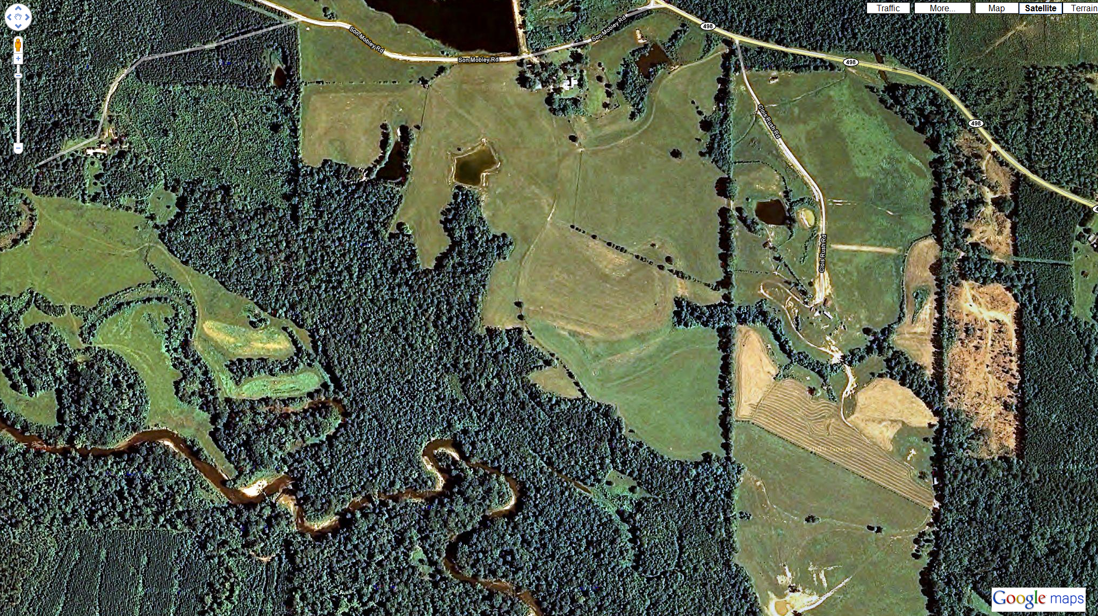
larger isolation
+
smaller habitable patches
+
lesser quality of habitats
More extinction now and later
Habitat loss

